Slide 1
UROLITHIASIS
Murtadha Almusafer
Professor & Consultant of Urology

Slide 2
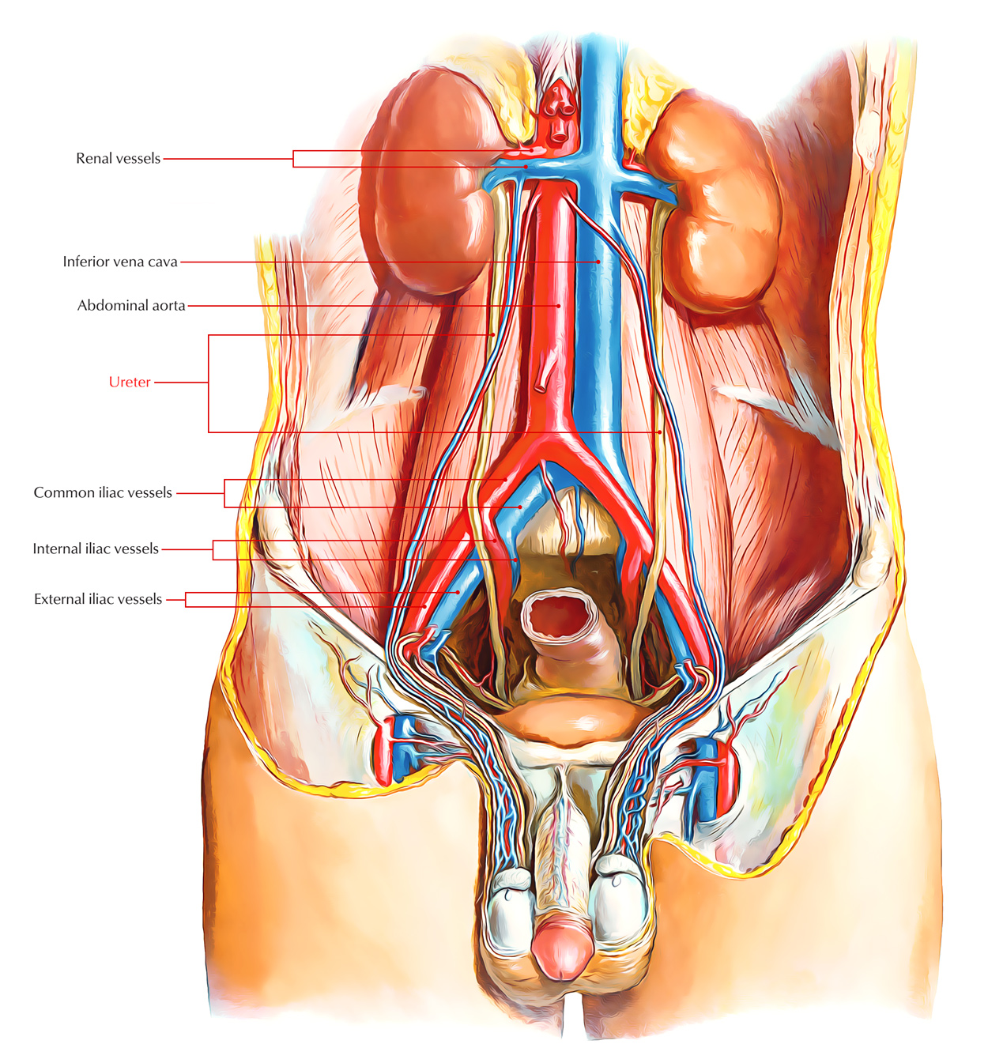
Anatomical points

Slide 3
A 30-year-old male patient with suspicion of left sided ureteric stone.
How could be presented with?
How can be treated?

Slide 4
History
Physical Examination
Investigations
Imaging
Treatment

Slide 5
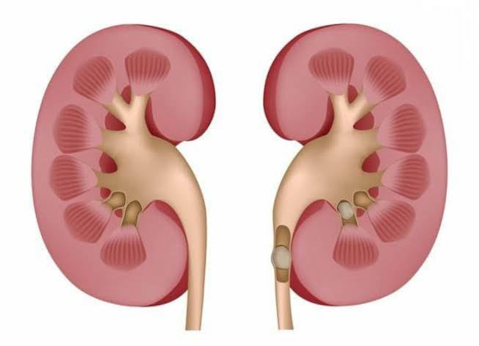
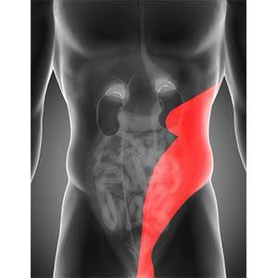
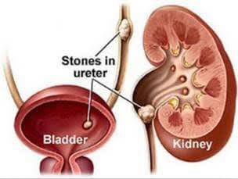
History

Slide 6
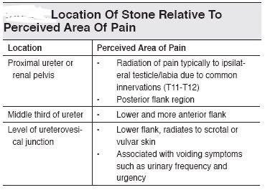

Slide 7
Examination
General
Abdominal

Slide 8
Investigations ?

Slide 9
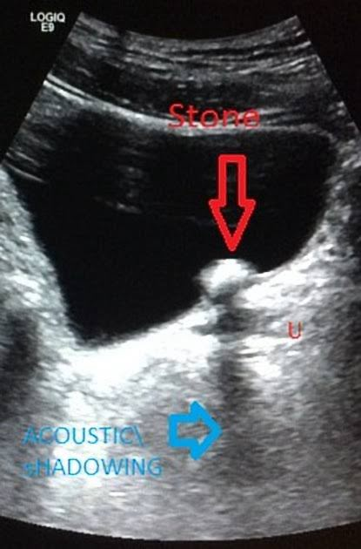
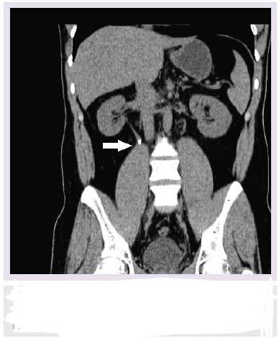
Imaging

Slide 10
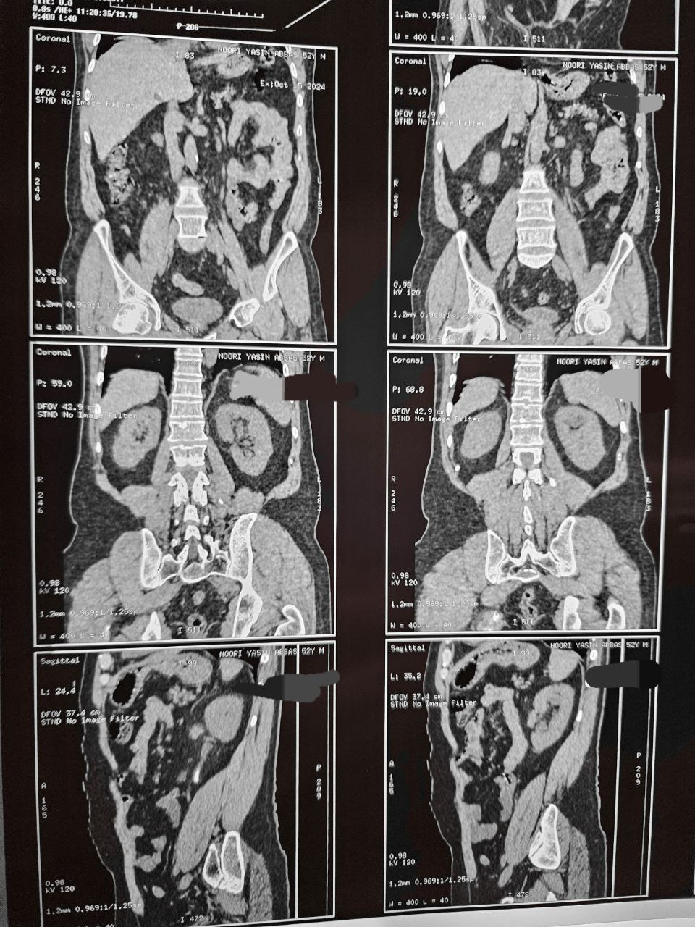
CT scan

Slide 11
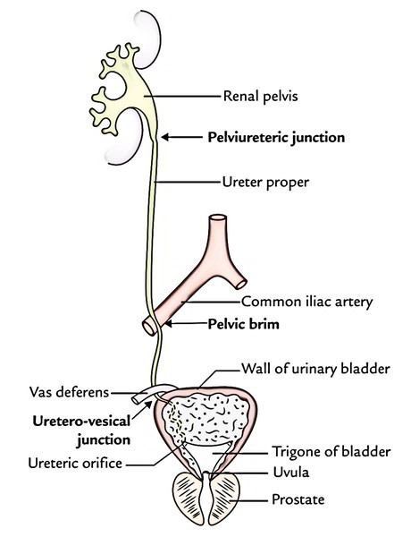
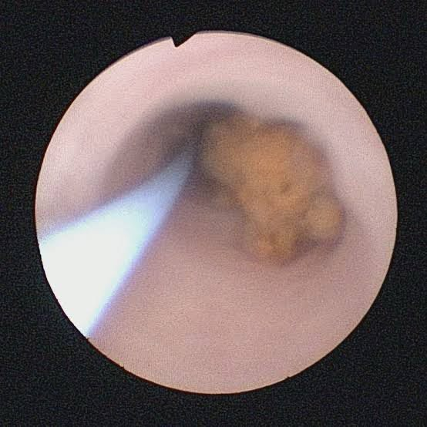
Treatment
Medical Expulsive
Therapy
What are the
Anatomical narrowing
of the ureter ?
Surgical Treatment

Slide 12
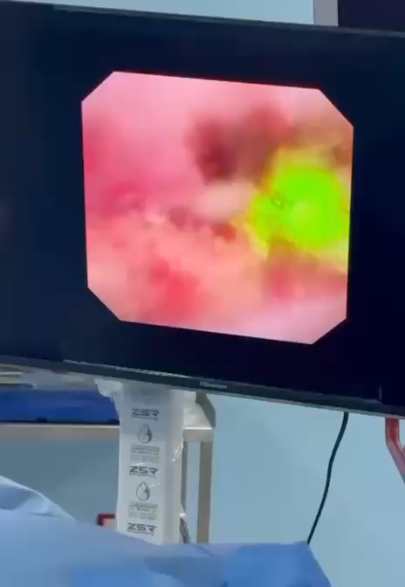

Slide 13
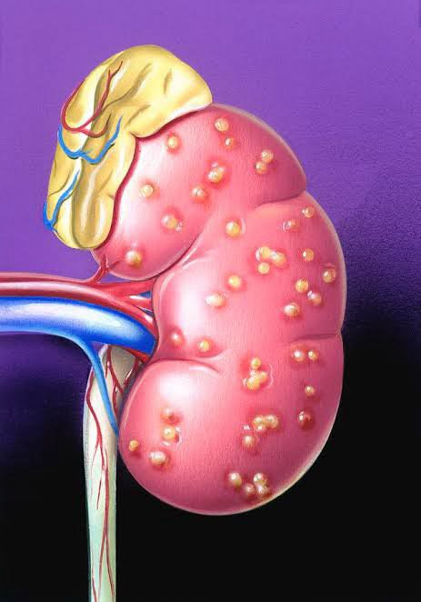
The same patient has
fever & rigor
What is your prompt diagnosis ?
How can be managed?

Slide 14
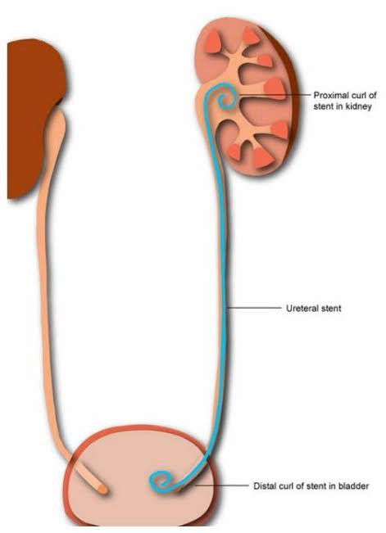
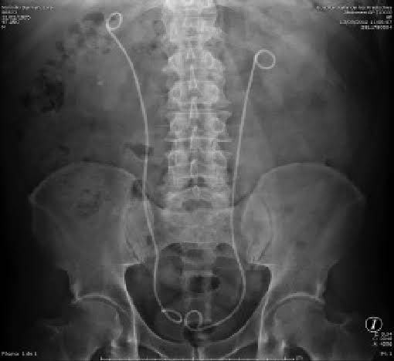
Double J Stent (JJ stent)

Slide 15
Complications of DJ Stents
Varied from :
Minor such as hematuria, dysuria, frequency (bladder irritation), flank and suprapubic pain
to
Major complications such as:
vesico-ureteric reflux, upward & downward migration, encrustation & stone formation, urinary infection,& stent necrosis

Slide 16
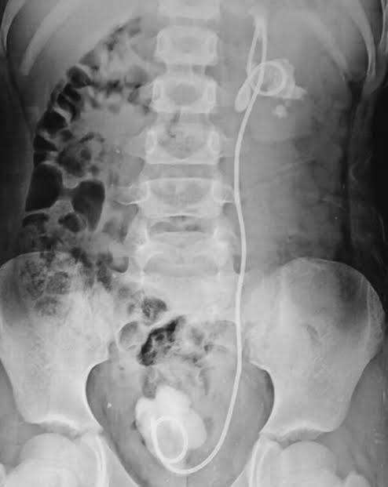
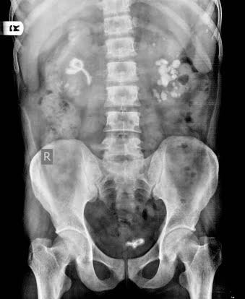
Complications of stents

Slide 17
The patient had a history of right-sided nephrectomy
What is the dangerous thing you should search for?

Slide 18
Another patient has a suspicion of right-sided renal stone
How can this patient be presented with?
How can be treated?
History, Physical Exam., Investigations, & Imaging
Treatment options

Slide 19
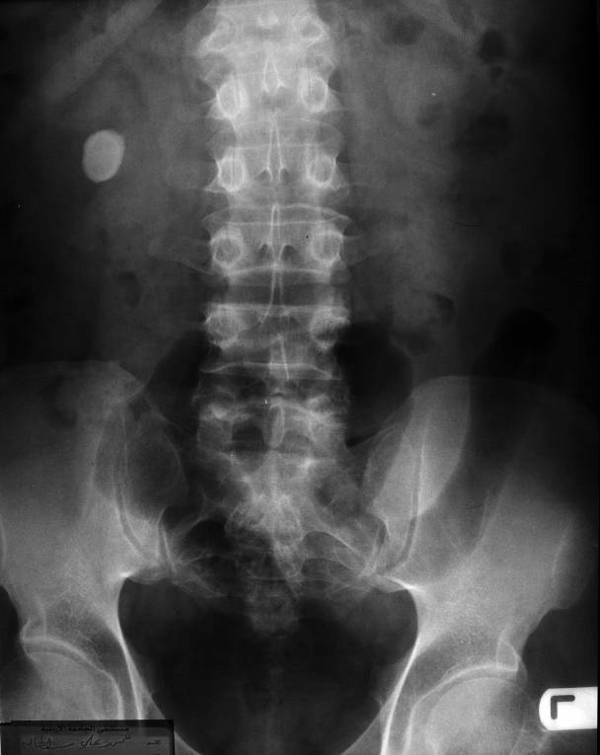
KUB

Slide 20
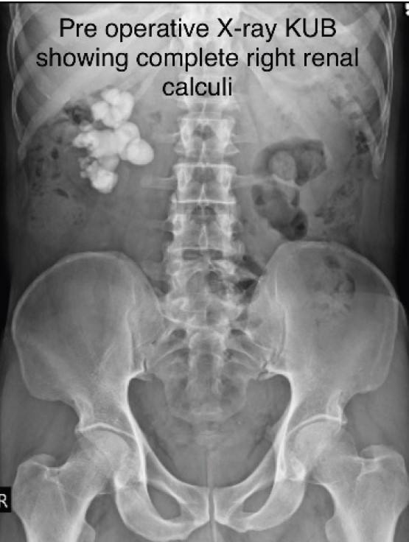
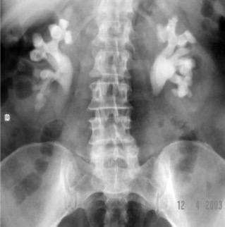
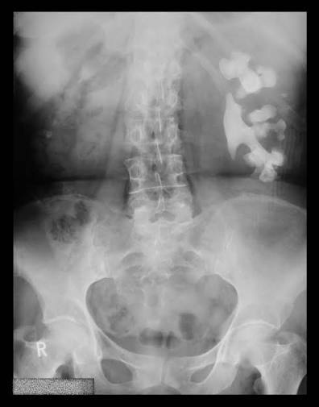
Staghorn Stone on KUB

Slide 21
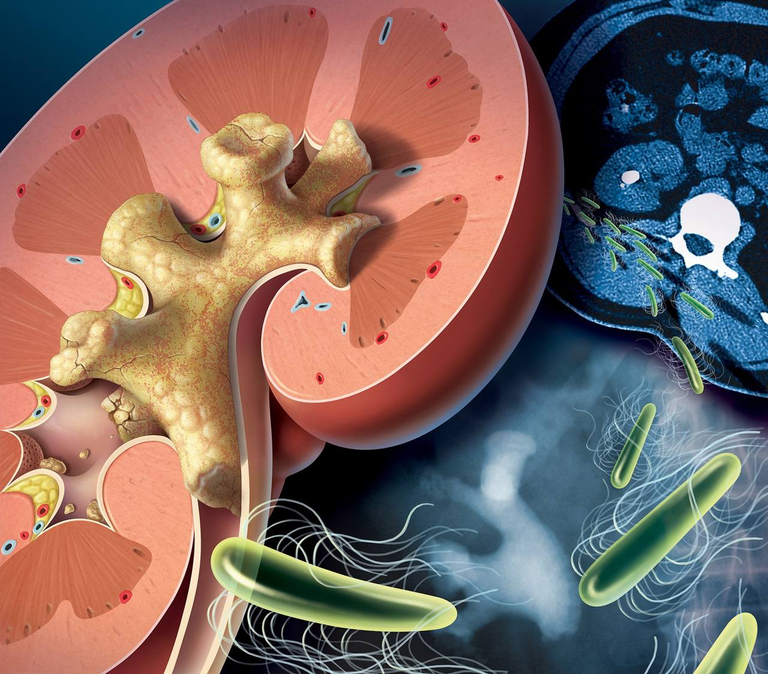

Slide 22
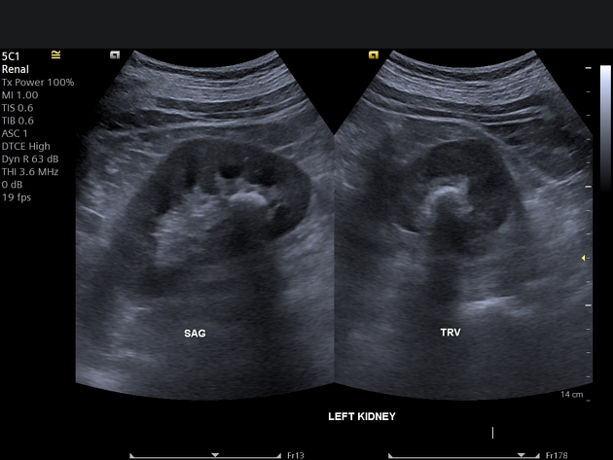
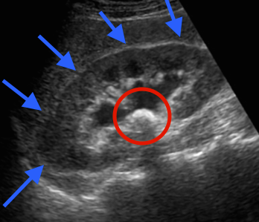
Imaging: Ultrasonography

Slide 23
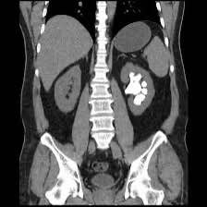
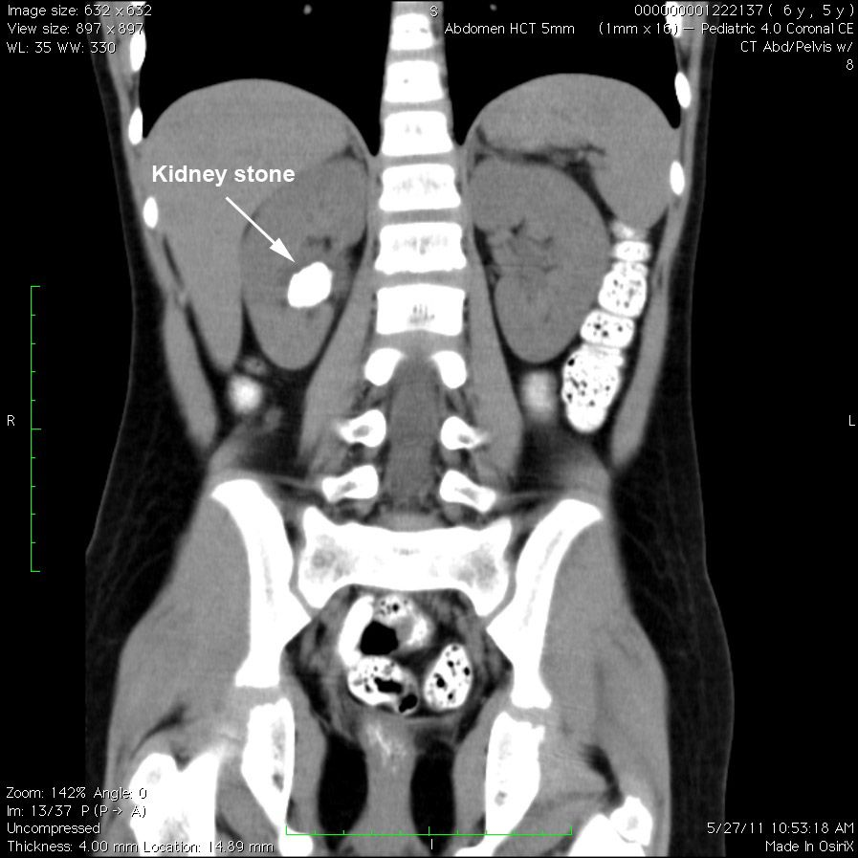
CT SCAN

Slide 24
A patient had a history of bariatric surgery 1-year ago What are the causes of developing renal stones?
What is the commonest stone type, and why?
Illustrate the changes responsible for stone formation

Slide 25
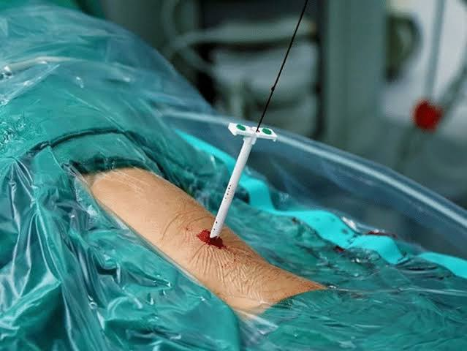
PCNL
The same patient underwent PNL
(Percutaneous Nephrolithotomy)
for his stone.
How you can follow the patient
in the ward?
What possible complications
might occur?
What are the contraindications
for PNL ?

Slide 26
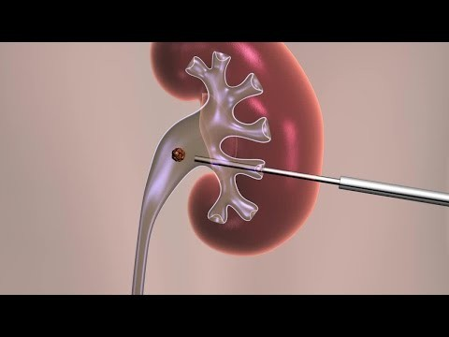
PCNL

Slide 27
Complications of PCNL
Percutaneous nephrolithotomy (PCNL) can lead to several complications, including:
Hemorrhage
infection, and sepsis
Perinephric Hematomas
Organ Injury like colon and lung
Urinary Leakage

Slide 28
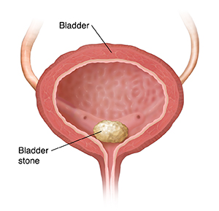
A patient suspected to have vesical stone
How can this patient presented with ?
What are the clinical findings ?
How can be presented with?
How you diagnose his/him ? Both investigations
& imaging
What are the treatment options?

Slide 29
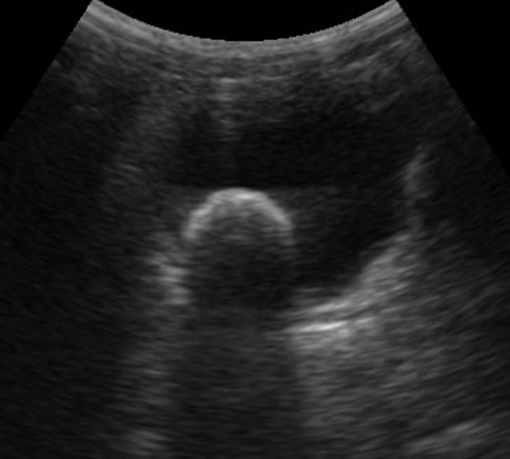
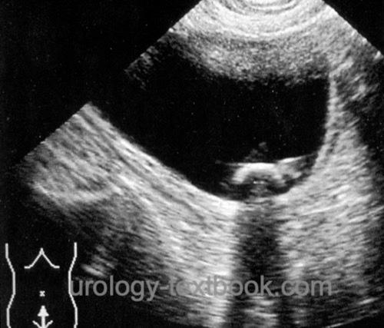
Ultrasound- Vesical Stones

Slide 30
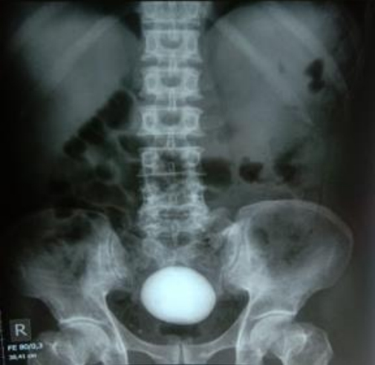
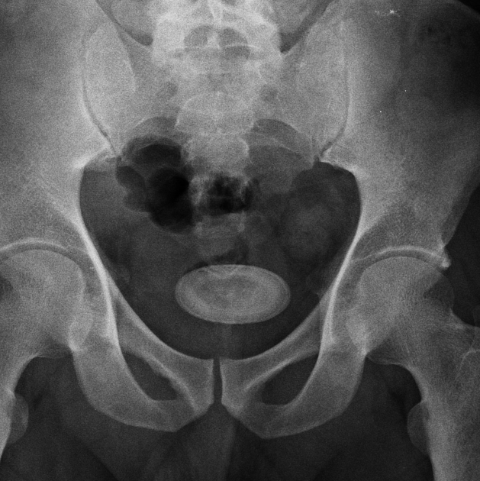
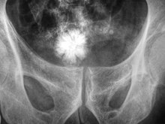
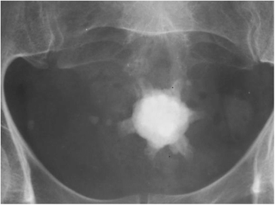
KUB- Vesical Stones

Slide 31
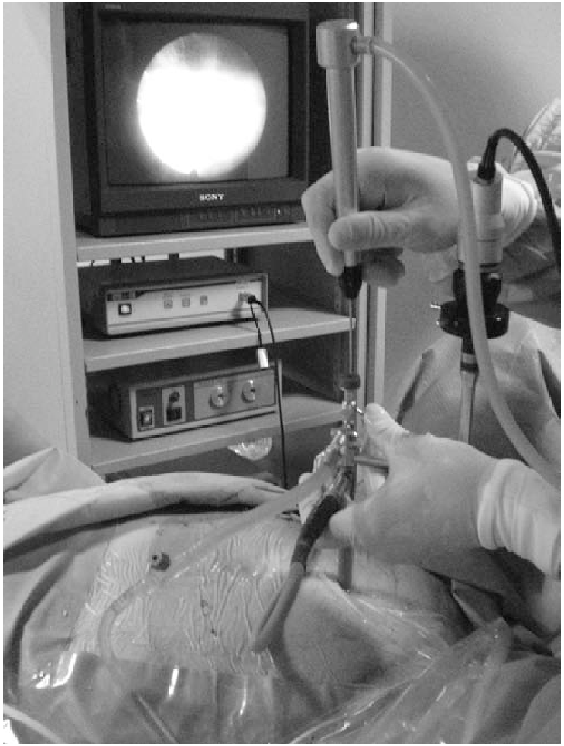
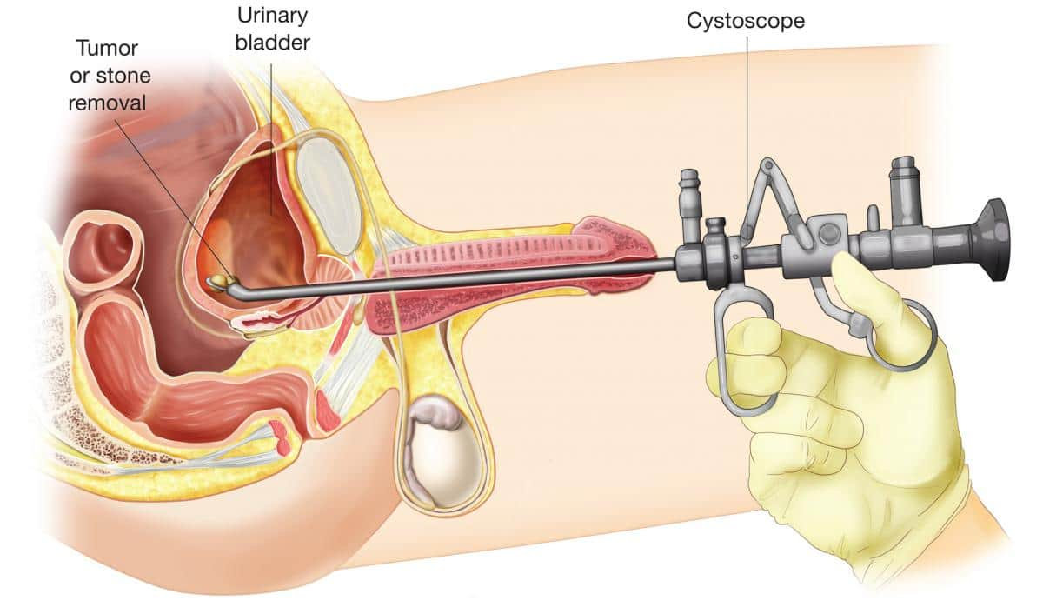
cystolitholapexy

Slide 32
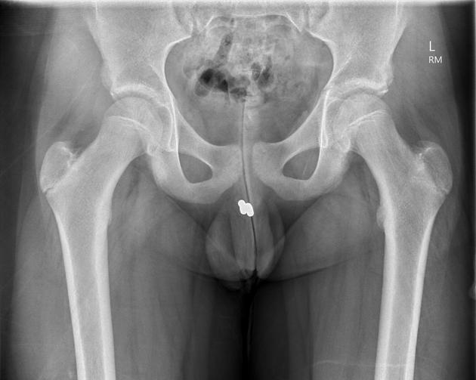
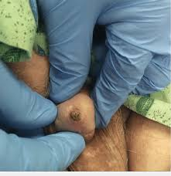
Urethral stone

Slide 33


